Slide 1

Logistic Regression
By : Talib Sir
AI/ML

Slide 2
Logistic Regression in Machine learning
Logistic regression is a supervised machine learning algorithm used for classification tasks where the goal is to predict the probability that an instance belongs to a given class or not.
Logistic regression is used for binary classification where we use sigmoid function, that takes input as independent variables and produces a probability value between 0 and 1.
For example, we have two classes Class 0 and Class 1 if the value of the logistic function for an input is greater than 0.5 (threshold value) then it belongs to Class 1 it belongs to Class 0. It’s referred to as regression because it is the extension of linear regression but is mainly used for classification problems.

Slide 3
Logistic Function – Sigmoid Function
The sigmoid function is a mathematical function used to map the predicted values to probabilities.
It maps any real value into another value within a range of 0 and 1. The value of the logistic regression must be between 0 and 1, which cannot go beyond this limit, so it forms a curve like the “S” form.
The S-form curve is called the Sigmoid function or the logistic function.
In logistic regression, we use the concept of the threshold value, which defines the probability of either 0 or 1. Such as values above the threshold value tends to 1, and a value below the threshold values tends to 0.

Slide 4
Types of Logistic Regression
On the basis of the categories, Logistic Regression can be classified into three types:
Binomial: In binomial Logistic regression, there can be only two possible types of the dependent variables, such as 0 or 1, Pass or Fail, etc.
Multinomial: In multinomial Logistic regression, there can be 3 or more possible unordered types of the dependent variable, such as “cat”, “dogs”, or “sheep”
Ordinal: In ordinal Logistic regression, there can be 3 or more possible ordered types of dependent variables, such as “low”, “Medium”, or “High”.

Slide 5
Assumptions of Logistic Regression
We will explore the assumptions of logistic regression as understanding these assumptions is important to ensure that we are using appropriate application of the model. The assumption include:
Independent observations: Each observation is independent of the other. meaning there is no correlation between any input variables.
Binary dependent variables: It takes the assumption that the dependent variable must be binary or dichotomous, meaning it can take only two values. For more than two categories SoftMax functions are used.
Linearity relationship between independent variables and log odds: The relationship between the independent variables and the log odds of the dependent variable should be linear.
No outliers: There should be no outliers in the dataset.
Large sample size: The sample size is sufficiently large

Slide 6
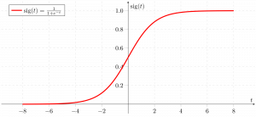
How does Logistic Regression work?
The logistic regression model transforms the linear regression function continuous value output into categorical value output using a sigmoid function, which maps any real-valued set of independent variables input into a value between 0 and 1. This function is known as the logistic function.

Slide 7
Cost function for Linear Regression
In Logistic Regression, the log-odds of a categorical response being "true" (1) is modeled as a linear combination of the features:
log(p/(1−p))=w0+w1x1,...,wjxj
=wTx
where:
w0 is the intercept term, and w1 to wj represents the parameters for all the other features (a total of j features).
By convention of we can assume that x0=1, so that we can re-write the whole thing using the matrix notation wTx.
This is called the logit function. The equation can be re-arranged into the logistic function:
p = {e^{w^Tx}}
{1 + e^{w^Tx}}

Slide 8
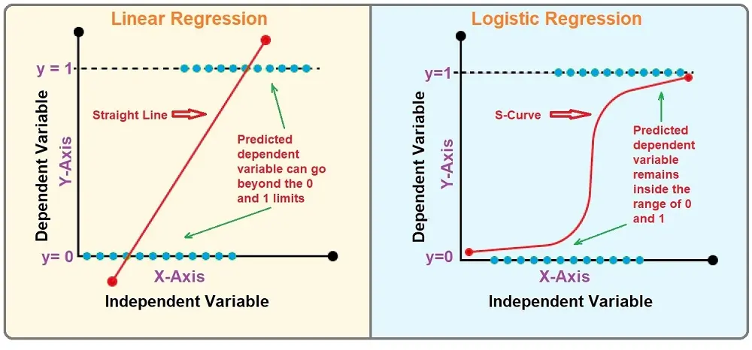
Difference between Linear and Logistic

Slide 9
The difference between linear regression and logistic regression is that linear regression output is the continuous value that can be anything while logistic regression predicts the probability that an instance belongs to a given class or not.
Linear Regression | Logistic Regression
Linear regression is used to predict the continuous dependent variable using a given set of independent variables. | Logistic regression is used to predict the categorical dependent variable using a given set of independent variables.
Linear regression is used for solving regression problem. | It is used for solving classification problems.
In this we predict the value of continuous variables | In this we predict values of categorical variables
In this we find best fit line. | In this we find S-Curve.
Least square estimation method is used for estimation of accuracy. | Maximum likelihood estimation method is used for Estimation of accuracy.
The output must be continuous value, such as price, age, etc. | Output must be categorical value such as 0 or 1, Yes or no, etc.
It required linear relationship between dependent and independent variables. | It not required linear relationship.

Slide 10
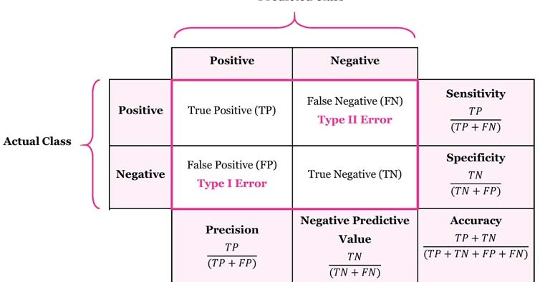
Performance metrics for classification
Confusion Matrix :

Slide 11
Accuracy : Accuracy provides the proportion of correctly classified instances.
Precision: Precision focuses on the accuracy of positive predictions.
Recall (Sensitivity or True Positive Rate): Recall measures the proportion of correctly predicted positive instances among all actual positive instances.

Slide 12

F1 Score: F1 score is the harmonic mean of precision and recall.

